Slide 1
COVID-19 Analysis:
Exploring International Trends in COVID-19 Cases and Deaths
Haley Miller, Maggie Samaan, Richard Hamilton, Aishwarya Karthik

Slide 2
Overview
Background
An epidemic refers to an unexpected increase in cases of disease in a specific area¹
A pandemic is an epidemic that has spanned across locations¹
COVID-19 is now the deadliest pandemic in the history of the United States, as of September 2021³
Scientists are now discussing COVID-19 as becoming endemic- a disease that continually circulates a population or area with occasional outbreaks⁵
Epidemic
Pandemic
Endemic

Slide 3
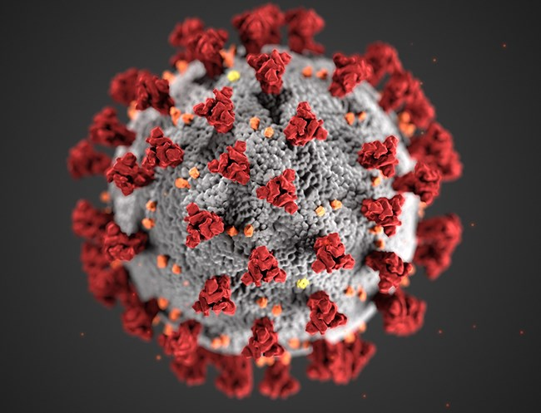
Purpose of COVID-19 Analysis
Create a functional prediction model relating to the healthcare/medical field
Several topics considered including cancer, malaria, and COVID-19
COVID-19 selected due to availability of current data
Analysis of COVID-19 to ultimately to predict the health outcomes in future populations
CDC/SCIENCE PHOTO LIBRARY

Slide 4
Data Source
Our World in Data (OWID)
Data
An organization that focuses on researching international crises including issues like climate change, war, and disease
Dataset compiled from multiple data sources including Johns Hopkins University, Oxford Government Response Tracker, UN, and World Bank
Along with information contained on the website, dataset and explanation of data easily accessible on OWID’s GitHub https://github.com/owid/covid-19-data
Several data fields within dataset continue to be updated daily (e.g. number of cases and deaths)
67 columns and 198,847 rows of data
Columns indicate international data including country, COVID-19 cases, COVID-19 deaths, vaccinations, population, and several other socioeconomic factors
Unique rows characterized by entries from a country on a certain date

Slide 5
Potential Outcomes of Analysis
Goals
Questions
Identify differences between the health outcomes of people from different countries
Predict new cases of COVID-19 in various countries
Determine the relationship between the spread of COVID-19 and health factors for global populations
Compare the accuracy of predicting new cases with a regression model and neural network
How can the number of daily new cases be predicted based on information such as cases, vaccinations, people vaccinated, and population density?
Can new cases be better predicted by a machine learning regression model or a neural network?
How can future health outcomes be predicted from this data?

Slide 6
Analysis
“As public health people, we’re often working in a little bit of the dark, trying to make our best estimates with really uncertain information”
-Dr. Bill Miller, The Ohio State University²

Slide 7
Analysis Roadmap
Exploratory Analysis
Running Machine Learning
Summarizing Analysis
Loading Data
Preprocessing Data
Creating Visualizations
Establishing Database
.
1
2
3
4
5
6
7

Slide 8
Data Exploration
Utilizing Python and Jupyter Notebook, the data was explored to determine the nature of each column, the number of values contained in each column, and the significance of each column
Due to the collection and variety of data, there were significant disparities in the data between both rows and columns
Challenge 1
Challenge 2
Challenge 3
Not all rows contained the same format of data
There were several null values within the dataset
Not all null values could be dropped as it would severely diminish necessary data points

Slide 9
Loading Data
AWS used to allow cohesive access of data and database to all group members
CSV file from 7/5/22 uploaded into S3 bucket to be accessed with PySpark
RDS instance created to connect to Postgres within local PgAdmin
Google Colab notebook created to start PySpark session and load data from CSV to a dataframe
An id_row was created to be the index for each row of data

Slide 10
Loading Data (cont.)
Data types were changed to match PySpark schema and schema in the database
Two dataframes were created; one to hold case specific data (number of cases, deaths, hospitalizations etc.) and one to hold demographic information (population, age, poverty, GDP)
Tables created in RDS instance to match data types and columns of the two separate dataframes
Data loaded from PySpark dataframes to Postgres

Slide 11
Establishing Database
The two tables (cases_data and demos_data) were joined together with a full outer join on the id_row column into a new table; combined_COVID_data
The data was filtered to only include valid countries within the location column and loaded into the table all_countries_data
All columns were maintained for further exploration for feature engineering
A connection was made from the database to the next phase of analysis-the machine learning component

Slide 12
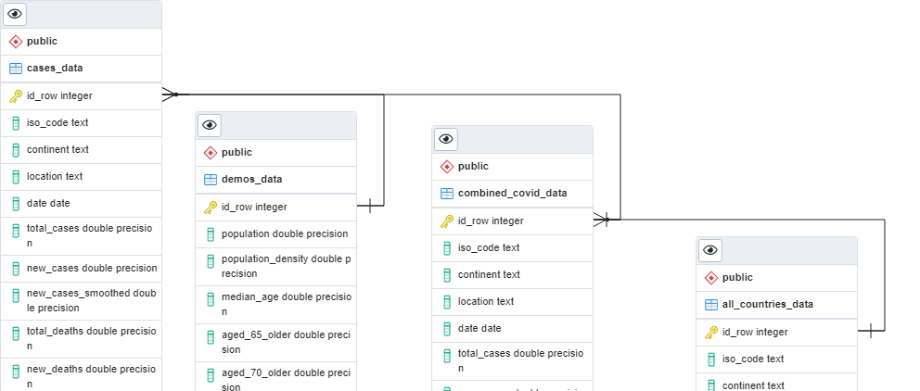
Establishing Database (cont.)
-ERD for tables created

Slide 13
Preprocessing Data
Dropping Data
COVID-19 dataset initially contained 198,846 rows of data organized in 67 columns between January 1st, 2020 and July 5th, 2022
All COVID-19 testing data was removed since testing policies, availability, interpretation, and reporting were sporadic and varied significantly among countries
Columns related to calculated excess_mortality were dropped as they are not relevant to the intended predictions
The columns related to Intensive Care Unit (ICU) and hospital admissions were removed due to containing a high number of null values
General columns with redundant information from other columns were dropped, leaving the dataframe with 43 columns

Slide 14
Preprocessing Data (cont.)
Addressing Missing Data
All null values from the total_cases column were dropped and the new_cases nulls were filled with zeros as the goal was to predict the number of daily new cases.
By dropping the missed values from total cases, the missing values of new cases decreased significantly and the remaining missing values from new cases were filled with zeros
Death-related columns would only be features in the COVID-related deaths prediction model but not in the daily new cases prediction model so they were separated into a different dataframe
The column reproduction_rate: represents a real-time estimate of the effective reproduction rate (R) of COVID-19 and there was no discernable reason for the number of missing values (31,175)
The missing values were dropped instead of being replaced with zeros to avoid skewing results leaving the dataframe with a total of 190 countries

Slide 15
Preprocessing Data (cont.)
Vaccination Columns
Out of 148,217 records, there were only 44,719 records with reported daily total vaccinations numbers from all 190 locations
The 103,498 total_vaccinations and total_vaccinations_per_hundered nulls were filled with zeros because the absence of vaccines emphasized certain trends in the pandemic
The column containing the number of people fully vaccinated was selected since the completion of vaccination regimen indicated a superior level of immunity against the virus
The window of analysis was shortened to include all records from 1/1/2020 up until 3/29/2022 since the daily vaccination reporting was inconsistent in many countries after that time
Following cleaning of vaccination columns, a total of 34 columns were left for feature engineering

Slide 16
Preprocessing Data (cont.)
Feature Engineering
Date column was converted to datetime and the dates were filtered to only include data from 1/1/2020 until 3/28/2022
A new column was created to reflect the number of days into the COVID-19 pandemic for each record, which ultimately replaced the date column
Additional columns were created to represent the differences between daily total vaccinations and daily people total vaccinated
New columns of daily differences in total vaccinations and people fully vaccinated were added to enhance the models interpretation of the cumulative numbers
All columns were then normalized to per 100,000 people of each location's population
The cleaned dataset was split into two dataframes: one for cases prediction and another for deaths predictions

Slide 17
Machine Learning
Model Selection
Random Forest Regressors are a type of ensemble learning models that combines multiple smaller models into a more robust and accurate model
Random forest models use a number of weak learner algorithms (decision trees) and combine their output to make a final regression decision
Structurally speaking, random forest models are very similar to their neural network counterparts
Random forest models have been a staple in machine learning algorithms for many years due to their robustness and scalability
Both output and feature selection of random forest models are easy to interpret, and they can easily handle outliers and nonlinear data

Slide 18
Machine Learning
Heatmap
With 99,856 records and 17 columns, all the variables were visualized with a heatmap to study their correlations using the Seaborn python library
Next, target was defined to be new_cases_per_100K and the rest of the 16 columns were the features
Then the data was split into training and testing subsets and standardized them with the StandardScaler
The training and testing subsets were split according the default of 75%, 25%, respectively. X_train shape: (74892, 16), X_test shape: (24964, 16), y_train shape: (74892,), y_test shape: (24964,)

Slide 19
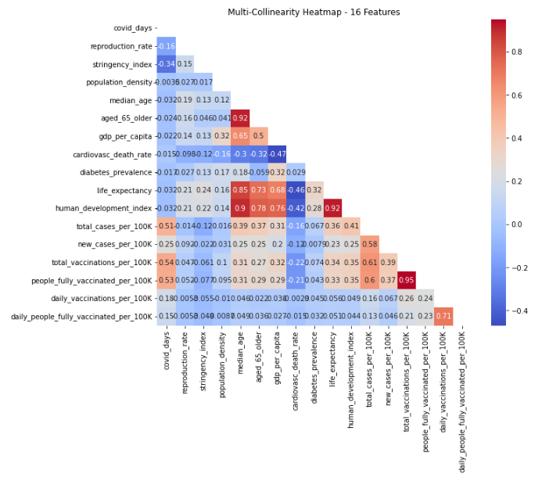
Model Selection
Heatmap of 16 features

Slide 20
Machine Learning (cont.)
Creating the Model
Established a random forest regression instance and chose 128 decision trees for the first run of the model, followed by fitting and evaluating the model on the scaled training and testing data, respectively
The model was scored using mean squared error, mean absolute error, and the R squared metrics
Matplotlib library was then to visualize the predictions against the actual new cases per 100k from the testing subset, in addition to plotting the residuals of predictions for the whole scaled dataset
The whole dataset was scaled and predictions were made on the 16 features
Then, added the predictions and calculated residuals to the features only dataframe and the dataframe with locations and raw numbers

Slide 21
Machine Learning (cont.)
Enhancing the Model
Feature importance was utilized and the RFR model was constructed based on the selected features only
Additional steps included removing an outlier, removing features with significant collinearity, increasing the number of estimators (decision trees)
PCA technique was applied it to all 16 features to decrease data dimensions
Then the dataset back was truncated to the beginning of a severe spike in new cases per 100K at the 730 days mark, and created a new dataframe of the first 720 days into the pandemic (88,039 records, 150 countries)
After observing the results from the previous step we truncated the days even further down to 700 days only (84,848 records of 150 countries)

Slide 22
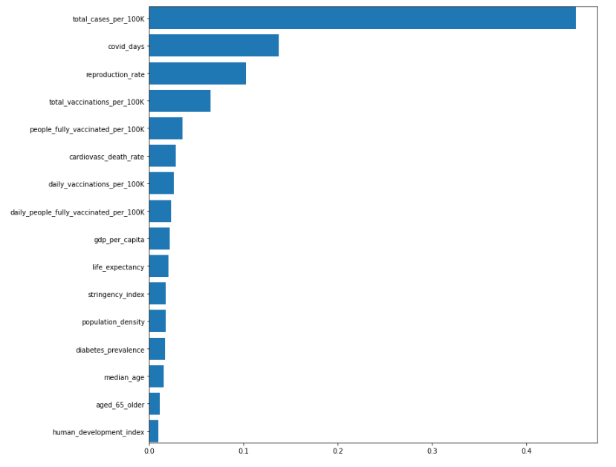
Model Selection
Feature Importance

Slide 23
Machine Learning (cont.)
Results
The Random Forest Regression model run on all 16 features got a prediction score of 77%
Rerunning the RFR model on selected features based on their importance to the prediction resulted in a lower testing score of 75%
Removing an outlier from the target new cases per 100K positively affected the performance of the RFR model, resulting in a R squared value of 0.808 and lower MSE of 457.205
Testing the RFR model on the reduced features (13) resulted in 77% as well
Using Principal Component Analysis on all 16 features and on non-collinear 13 features, with and without increasing the number of decision trees in the Random Forest was worse than other enhancement techniques and did not help the model for a better fit as evidence in the negative R squared scores achieved from both attempts

Slide 24
Machine Learning (cont.)
Results
Truncating the records down to 720 days into the pandemic had a positive influence on the RFR model performance
While the R squared score remained at 77.4%, the mean squared error dropped significantly
Truncating the records down to 700 days into the pandemic had a positive influence on the RFR model performance
While the R squared score remained at 77.4%, the mean squared error dropped significantly

Slide 25
 | R Squared | Mean Absolute Error | Mean Squared Error | Root mean Squared Error
RFR -16 | 0.769 | 4.781 | 570.731 | 23.890
Feature Importance | 0.752 | 5.951 | 596.332 | 24.420
No outlier | 0.808 | 4.710 | 457.205 | 21.382
No Collinear | 0.770 | 4.777 | 568.454 | 23.842
300 Trees | -0.235 | 23.307 | 2972.592 | 54.521
300 - no collinear | 0.773 | 4.751 | 560.722 | 23.680
PCA | -0.119 | 22.460 | 2694.212 | 51.906
720 days | 0.774 | 2.672 | 94.215 | 9.706
700 days | 0.78 | 2.62 | 80.40 | 8.97
Rsults

Slide 26
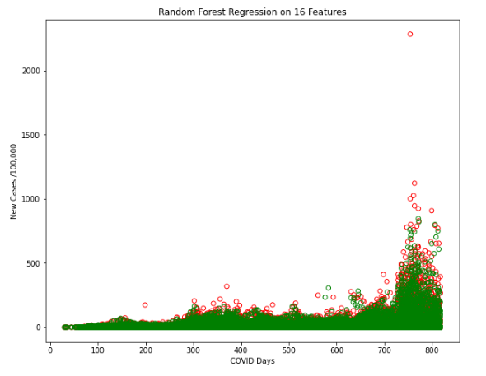
Model Selection
Random Forest Regression with Predicted Values

Slide 27
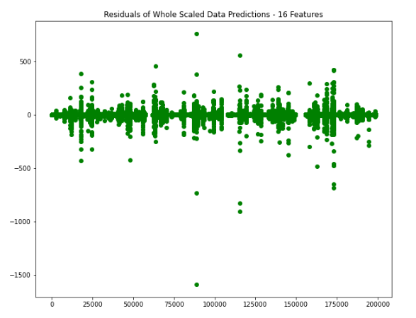
Model Selection
Random Forest Regression (16 Features) Whole Scaled

Slide 28

Creating Visualizations

Slide 29
Summarizing Analysis
We were able to predict the daily number of new COVID-19 cases in 150 countries across the world using Random Forest Regression models with ranging accuracy from 77% to 81%.
We attempted different techniques to enhance the model including selecting features based on importance, dropping features with severe multicollinearity, increasing the number of decision trees, and reducing the dimension of the data using Principal Component Analysis. Not all enhancement techniques were beneficial.
Changing the time frame of the analysis and escaping new spikes in the pandemic had steady positive effects on predictions. Insinuating the changing nature of the pandemic due to the rise of new COVID-19 variants that were not accounted for in the original dataset.

Slide 30
Summarizing Analysis (cont.)
The change in the nature of the virus with every new wave might have confused the model that depended on steady factors like protective public health measures including vaccinations.
At the beginning of the pandemic, the vaccinations were directed as neutralizing immunity against the virus which showed on the prediction pattern of new cases. However, later on in the course of the pandemic and as new variants of COVID-19 emerged, the effects of the vaccinations might have been diluted.
Deep Learning Neural Networks were very computationally expensive and did not provide superiority to Random Forest Regression models.

Slide 31
Summarizing Analysis (cont.)
Limitations
Time and Resources
Huge gaps in reporting between locations, inconsistent calculations, and absent important informations such as public adherence to protective measures.
Further analysis is recommended on separate countries to further evaluate the weaknesses of the collective dataset.
“All models are wrong, it’s striving to make them less wrong and useful in the moment”
-Mark Weir, The Ohio State University²

Slide 32
Technologies, Languages, and Tools Used
Software and Framework
Libraries and Packages
(3.7.13), Jupyter Notebook (6.4.11), Anaconda (4.13.0), PostgreSQL (11.15-R1), Tableau (2020.4), pgAdmin4 (6.7), Spark (3.2.1), Visual Studio Code (1.65.0)
Pandas (1.3.5), matplotlib (3.5.1), NumPy (1.21.5), PySpark, JAVA, PostgreSQL driver, MLlib, Scikit-learn (1.0.2), Scikit-learn (0.23.2) for Ensemble Learning, imbalanced-learn library (0.7.0) tensorflow (2.3.0), keras-applications (1.0.8), keras-preprocessing (1.1.2), psycopg2 (2.9.3)
Online Tools
AWS RDS, AWS S3, Google Colaboratory Notebooks, [COVID-19_Analysis GitHub Repository]

Slide 33
Questions?
max growth

Slide 34
References
Centers for Disease Control and Prevention. (2012, May 18). Principles of Epidemiology. Centers for Disease Control and Prevention. Retrieved July 24, 2022, from https://www.cdc.gov/csels/dsepd/ss1978/lesson1/section11.html
Koerth, M., Bronner, L., & Mithani, J. (2020, March 31). Why it's so freaking hard to make a good COVID-19 model . FiveThirtyEight. Retrieved July 24, 2022, from https://fivethirtyeight.com/features/why-its-so-freaking-hard-to-make-a-good-covid-19-model/
Lovelace, B. (2021, September 20). Covid is officially America's deadliest pandemic as U.S. fatalities surpass 1918 flu estimates. CNBC. Retrieved July 24, 2022, from https://www.cnbc.com/2021/09/20/covid-is-americas-deadliest-pandemic-as-us-fatalities-near-1918-flu-estimates.html
Ritchie, H., Mathieu, E., Rodés-Guirao, L., Appel, C., Giattino, C., Ortiz-Ospina, E., Hasell, J., Macdonald, B., Beltekian, D., & Roser, M. (2020, March 5). Coronavirus pandemic (COVID-19). Our World in Data. Retrieved July 24, 2022, from https://ourworldindata.org/coronavirus
Zarefsky Contributing News Writer, M. (2022, April 1). How we will know when covid-19 has become endemic. American Medical Association. Retrieved July 24, 2022, from https://www.ama-assn.org/delivering-care/public-health/how-we-will-know-when-covid-19-has-become-endemic

